Slide 1
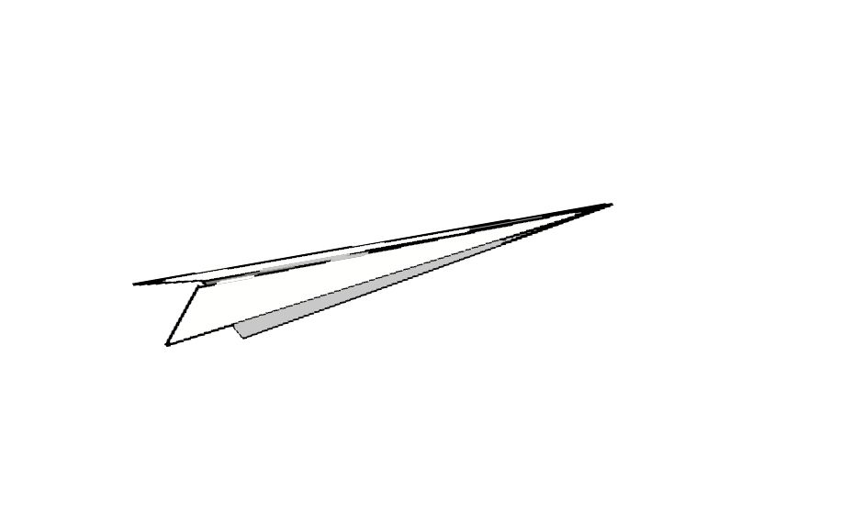
ORIGAMI PLANE
Presented by:
Rupesh Thakur(071/BCT/50)
Saroj Subedi (071/BCT/56)

Slide 2
Presentation outlines
INTRODUCTION
PURPOSE AND DESCRIPTION
OBJECTIVE
DEVELOPMENT TOOLS
GAME DESCRIPTION
IMPLEMENTATION DETAILS

Slide 3
Introduction
ORIGAMI PLANE is a 2D platformer game inspired from the most famous game during our childhood , “COPTER” originally a flash player game.
During the timeline many developer developed games based on its concept using many game engine such as Unity, Buildbox, etc.
The most popular recently is “FLAPPY BIRD”.

Slide 4
Purpose And Description
Develop a game that will entertain everyone
Make an personal achievement
Enhance knowledge and skills
Inspired by the success of Flappy bird and Copter

Slide 5
Objective
To develop an never ending game application for desktop
To provide an addictive experience that will enhance critical and fast thinking for the users
To learn and enhance knowledge in C++

Slide 6


Development Tools
Code Blocks and Turbo C++ is a C++ IDE built to meet the most demanding needs of its users. It is designed to be very extensible and fully configurable.

Slide 7
Game Description

Slide 8
Simplicity
The game is fairly simple because you just need to jump the plane and guide it safely avoiding all the obstacles. It has no complicated gameplay and mechanism.

Slide 9
User Friendly
The game is user friendly because anyone can play it without even knowing the kind of gameplay. All we need is to do is press any key to jump.

Slide 10
Competitive
It is a competitive game because it is a high score based game. The player will always try to beat his/her high score over and over again.

Slide 11
Addictive
The game is addictive because it has no end , it is an infinite game. The game won’t end because your highscore will keep on getting higher, with increase in game speed.

Slide 12
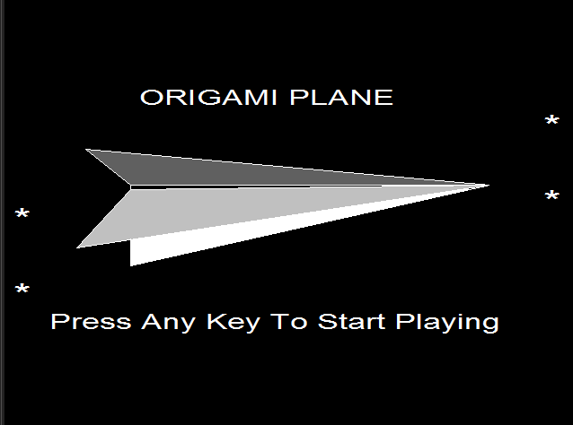
Screenshots

Slide 13
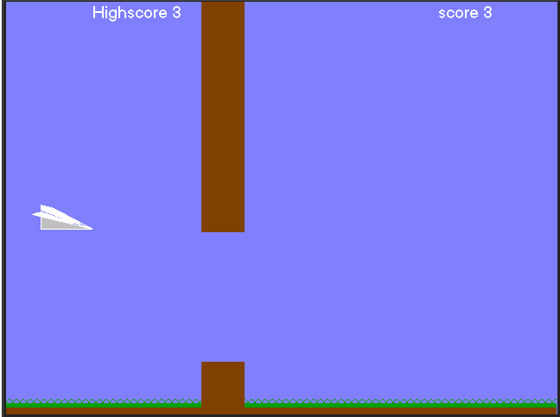
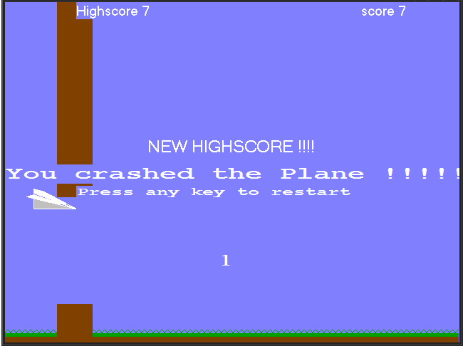

Slide 14
Implementation Details

Slide 15
Function execution sequence:
Main()
Splash()
Fail()
Countdown()

Slide 16
How we made the game is the major difference to those already made.
We made the game from the scratch, designing the plane using bunch of lines providing x and y co-ordinate unlike making a plane in paint and importing as an asset in a game engine.

Slide 17
The plane is always dropping down which can be explained as the body co-ordinates of plane is always incrementing its y co-ordinate unless the player hits any keyboard button.
With the hit of any keyboard button the y coordinate of every point of plane decreases.
The idea behind the collision of the plane is comparing each x and y coordinate of the plane body with the front-face of the pipe, ground having certain y coordinate and top y coordinate.

Slide 18
When the collision criteria is met, a function fail() is called which freezes the game and calls a function countdown() which gives user a count of 3 until the user can restart the game .
The untimely pressing of any keyboard button will lead the game to exit.

Slide 19
THANK YOU!!
-Rupesh Thakur(071/BCT/50)
-Saroj Subedi (071/BCT/56)

